Slide 1
Outline Of Today’s Discussion
Are Faces ‘Special’ Objects?
Visual Imagery

Slide 2
Part 1
Are Faces Special Objects/Forms?

Slide 3
Are Faces Special?
We are able to recognize faces (particularly important faces) despite considerable changes in lighting and size.
Face recognition is important because social information (including mood) is conveyed in faces.
However, face recognition can be disrupted by reversing the contrast polarity (i.e., light to dark, and vice versa).

Slide 4
Are Faces Special?
Demo
If you know who this is, raise your hand.

Slide 5
Are Faces Special?
Although our ability to recognize faces and expressions does not depend on scale, it DOES depend on orientation.
Try to identify the expression in the following picture…

Slide 6
Are Faces Special?
Six emotions are typically recognizable in faces
These are sadness, disgust, surprise, happiness, anger, fear.
Can you identify which is which….(DEMO)

Slide 7
Are Faces Special?
Prosopagnosia is a condition in which a patient knows that a face is a face…but can’t recognize whose face it is.
The inferotemporal (I.T.) brain region is almost always damaged in patients with prosopagnosia.
Although prosopagnosics can’t identify faces, they show other autonomic nervous system responses to familiar faces.

Slide 8
Are Faces Special?
The argument that “Faces Are Special” is bolstered by two unique characteristics of face recognition.
First, most people can classify face sub-categories (“That’s Bill Clinton”) as quickly as the broad category (“That’s a face”).
Second, there seems to be a well localized brain region, I.T., dedicated to face recognition.

Slide 9
Are Faces Special?
Some researchers argue that faces, per se, are NOT special.
They argue, instead, that non-face stimuli can also be associated with the same two characteristics of face recognition (sub-ordinate level classification, and strong I.T. response).
Meet the greebles….

Slide 10
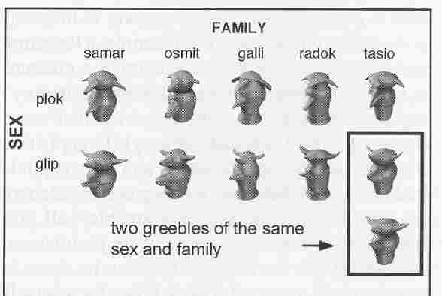
Greebles, Meet The Greebles
Booges, Quiff, and Dunth

Slide 11
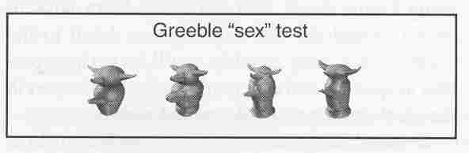
Greebles, Meet The Greebles
Novices can tell Glips (upward protrusions)
from Ploks (downward protrusions).
Novices cannot recognize individual greebles.

Slide 12
Are Faces Special?
With several thousand trials of practice, a person make can sub-ordinate level and broad-level identifications with equal speed.
Also, the more expertise a person has in subordinate-level greeble classification, the more I.T. becomes active in MRI studies.
So, maybe faces are not “special”.

Slide 13
Part 2
Visual Imagery

Slide 14
Visual Imagery
Visual imagery is the process of internally experiencing vision in the absence of retinal stimulation.
How much anatomical overlap is there between visual imagery and vision?
fMRI work has shown that area V1 is active during visual imagery. V1 is also obviously a brain region critical for stimulus-driven vision.
Here’s the stimulus that Kosslyn used in the MRI study.

Slide 15
Visual Imagery
Demo
Note the 4 quadrants. Then Close Your Eyes.

Slide 16
Visual Imagery
Note that Kosslyn used at “TYPE A” study on something as elusive as visual imagery!!!
But fMRI studies only passively eavesdrop on neural activity….
Suppose we want to actively CHANGE neural activity during visual imagery.
Transcranial Magnetic Stimulation (TMS) to area V1 slowed reaction times by 200 msec whether subjects actually viewed the stimuli, or engaged in imagery.

Slide 17
